Slide 1

Data Analysis Essentials
Cornerstone Project — Second Review
LIBRARY MANAGEMENT DATA ANALYSIS SYSTEM
Presented by
CH. TEJA - 25B11AI203
J. SAHITHI - 25B11AI417
K. SOWMYA - 25B11AI502
P. SUPRAJA - 25B11AI906
Department
Department of Artificial Intelligence & Machine Learning

Slide 2

SECOND REVIEW — WHAT MUST BE DEMONSTRATED
This project emphasizes completed implementation, evidence, analysis results and interpretation.
1. Implementation
Working notebook/code, successful execution and analysis outputs
2. Preprocessing
Actual missing-value treatment, duplicate removal, date transformation and final dataset
3. Analysis
Issue/return analysis, borrowing statistics, category analysis and patterns
4. Visualization
Bar, pie and line charts with clear interpretation
5. Results
Key findings, borrowing patterns, conclusions and recommendations
6. Presentation
Report/notebook evidence and clear individual contribution

Slide 3
PROJECT OVERVIEW — LIBRARY MANAGEMENT DATA ANALYSIS SYSTEM
Problem: To analyze library records and understand book borrowing patterns.
Objective: Analyze book issue and return records, find the most borrowed books, analyze student borrowing statistics, perform category-wise analysis, visualize the results and support book recommendations.
Domain: Library Management
Dataset used in this project: Library transaction records with book, student, category, issue, return and status information.
Outcome: The project helps identify borrowing patterns and provides useful insights for library management.
Analysis Focus
Book issue/return status and borrowing patterns are analyzed to understand library usage.
Important Features
Book Title, Category, Student_ID, Issue_Date, Return_Date, Status, Author
Tools
Python, Pandas, NumPy, Matplotlib, Google Colab

Slide 4
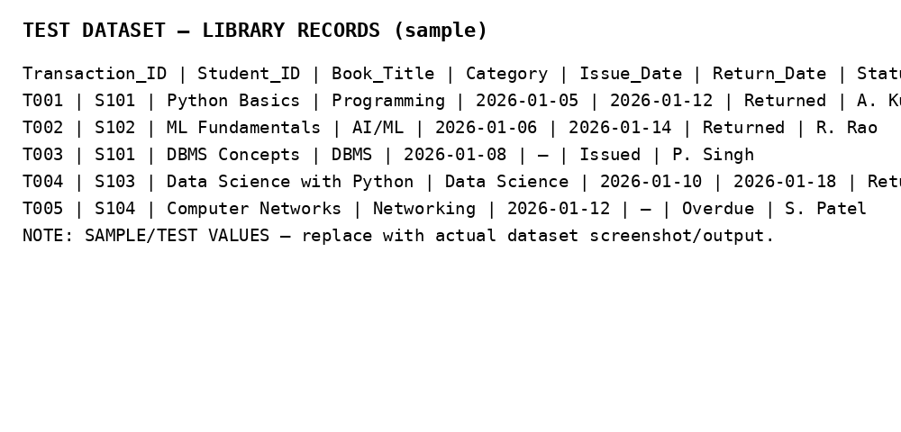
DATASET SNAPSHOT — BEFORE & AFTER CLEANING
Check | Before | After
Rows | 500 | 498
Columns | 10 | 10
Missing values | 4 | 0
Duplicate rows | 2 | 0
Date format | Mixed | Standardized

Slide 5
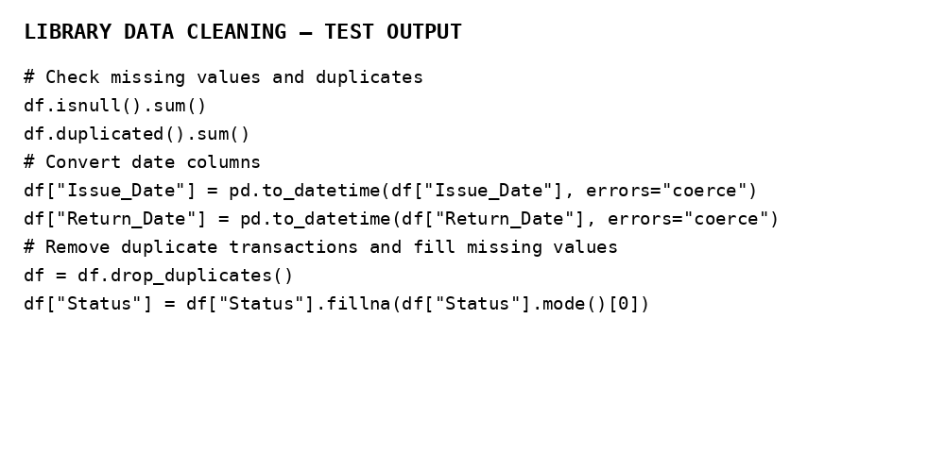
IMPLEMENTATION — DATA PREPROCESSING WITH EVIDENCE
Step 1 — Duplicates
Detected and removed duplicate library transaction records.
Step 2 — Missing Values
Missing values were identified and handled using suitable filling methods.
Step 3 — Final Check
Re-checked null count, duplicate count and date formats after cleaning.
Result
Clean library dataset prepared for exploratory analysis and visualization.

Slide 6
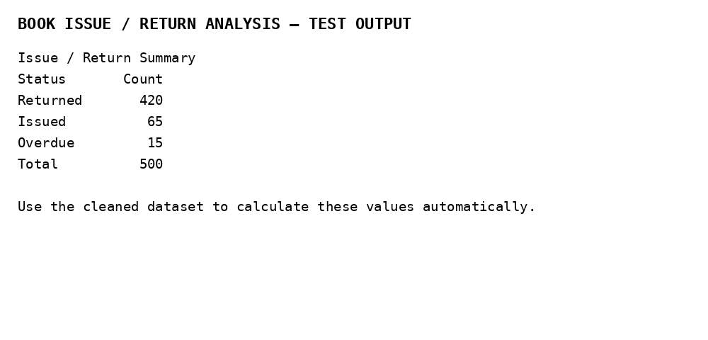
DATA ANALYSIS — EXPLORATORY RESULTS
Interpretation
Issue and return records are compared to understand how many books were issued, returned and still not returned.
Borrowing frequency is analyzed to identify the most borrowed books and understand overall library usage.

Slide 7
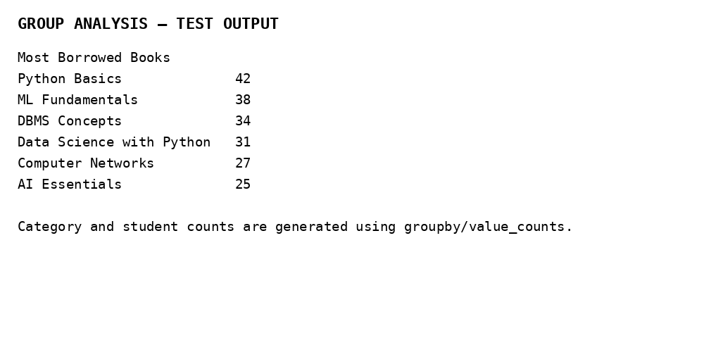
DATA ANALYSIS — GROUP COMPARISONS
Student insight
Student-wise borrowing counts are compared to identify borrowing patterns and students with higher borrowing activity.
Category insight
Category-wise borrowing is compared to identify popular book categories and understand student interests.

Slide 8
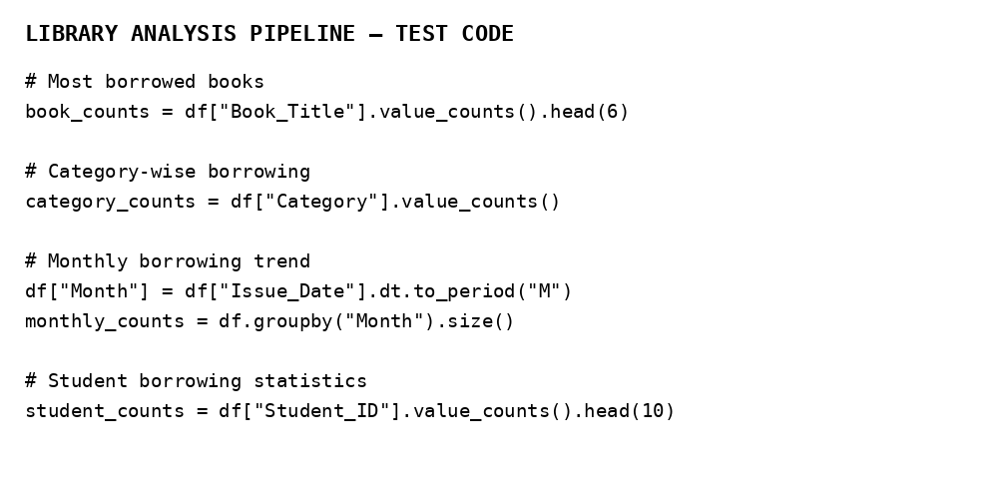
PROJECT IMPLEMENTATION — DATA ANALYSIS
Analysis Modules
Issue & return analysis; most borrowed books; student borrowing statistics; category-wise analysis.
Processing Pipeline
Load dataset → inspect data → clean records → convert dates → calculate borrowing statistics → generate visualizations.
Execution
Python and Pandas are used to process the cleaned library records and generate analysis outputs.
Output
Analysis tables and visualizations are generated for books, students, categories and monthly borrowing trends.

Slide 9
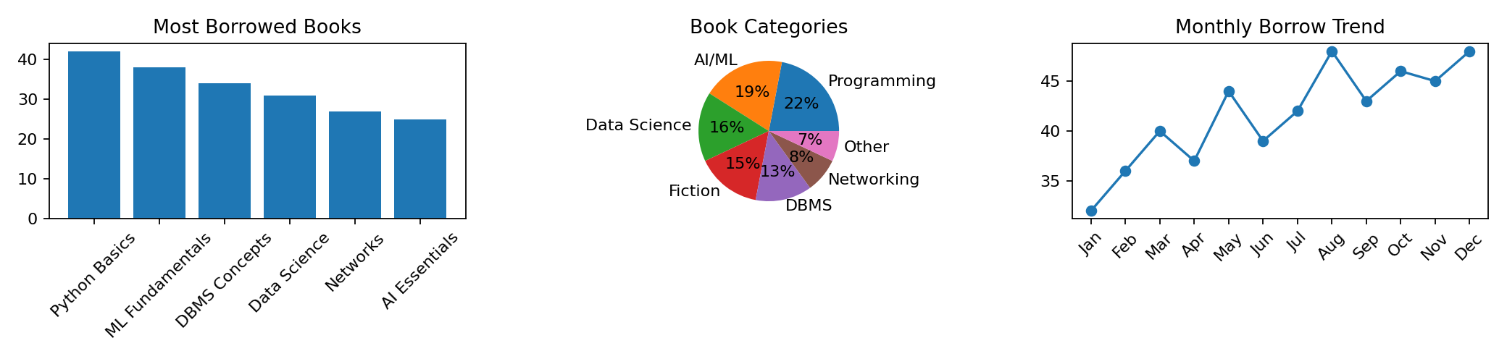
VISUALIZATION & INTERPRETATION
Popular Books — Bar Graph
Shows the books borrowed most frequently and helps identify high-demand titles.
Book Categories — Pie Chart
Shows the distribution of borrowing across book categories.
Monthly Borrow Trend — Line Chart
Shows how borrowing activity changes over time based on Issue_Date.

Slide 10
RESULTS & KEY INSIGHTS
Finding 1
In the test dataset, 420 records are returned, 65 are currently issued and 15 are overdue.
Finding 2
Python Basics is the most borrowed test title with 42 borrowing records.
Finding 3
Programming is the largest test category with 110 borrowing records; monthly borrowing varies across the year.
Analysis Output
Most borrowed books
Analysis Output
Student borrowing statistics
Analysis Output
Category-wise and monthly borrowing trends
The completed pipeline moves from raw library records → cleaning → preprocessing → EDA → analysis → visualization → insights. The results are based on the cleaned dataset and are used to understand library usage patterns and support future book recommendations.

Slide 11
PROJECT REPORT & PRESENTATION EVIDENCE
Report contents completed
Problem statement • Dataset description • Preprocessing • EDA • Analysis • Visualizations • Results • Conclusion
Evidence to show in viva
Notebook execution, cleaned dataset, analysis outputs, charts and result observations.
Notebook / Code
Working Python code organized into logical sections with outputs retained for review.
Individual contribution
Each student should explain the part they implemented and justify their analysis choices.
Presentation
Charts are labelled; each major visualization is accompanied by an interpretation.
Important
Do not paste only screenshots. Students must be able to explain what the code and output mean.

Slide 12
COMPLETED PROJECT WORKFLOW
Raw Dataset
Data Inspection
Cleaning
Date Preprocessing
EDA
Data Analysis
Visualization
Results
Insights / Report

Slide 13
VIVA VOICE — WHAT EACH STUDENT SHOULD BE READY TO EXPLAIN
Dataset
Why was this library dataset selected? What do Book Title, Category, Student_ID, Issue_Date, Return_Date, Status and Author represent?
Preprocessing
Why were missing values handled? Why were duplicate records removed? Why were dates converted into proper format?
EDA
What does each graph show? Why were bar, pie and line charts selected?
Analysis
How are most borrowed books, student borrowing statistics and category-wise patterns calculated?
Results
What do the issue/return, popular-book, category and monthly-trend results tell us?
Contribution
Which part did you personally implement? What problems did you face and solve?
A student should be able to run or explain the relevant code, interpret its output, and defend the choices made. Viva is an individual assessment even when the project is completed as a team.

Slide 14
CONCLUSION — SECOND REVIEW
The Library Management Data Analysis System demonstrates a complete data-analysis workflow.
The library records were inspected, cleaned, transformed and analyzed.
EDA and visualizations are used to identify borrowing patterns, popular books, student borrowing activity and category-wise usage.
The final analysis supports better understanding of library usage and can be extended with book recommendation features.

Slide 15
THANK YOU

